Slide 1
Program Compilation Symbol Table and Error Handing

Slide 2
Objectives
At the end of the lesson students should be able to
State what is meant by the symbol table
State the purpose of the symbol table
Give example of the symbol table
Solve problem relating to the symbol table
Describe the error handling process in compiling a program

Slide 3

Error Handling

Slide 4
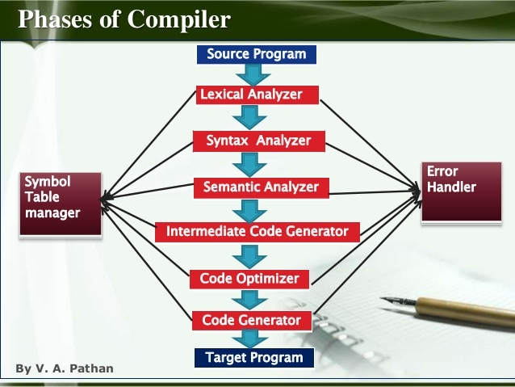
Error Handling
Each phase can encounter errors. After detecting an error, a phase must handle the error so that compilation can proceed.
In lexical analysis, errors occur in separation of tokens.
In syntax analysis, errors occur during construction of syntax tree.
In semantic analysis, errors may occur at the following cases:
When the compiler detects constructs that have right syntactic structure but no meaning
During type conversion.
In code optimization, errors occur when the result is affected by the optimization.
In code generation, it shows error when code is missing

Slide 5
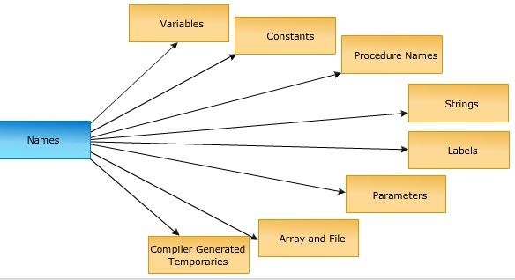
Complier Design
Symbol Table

Slide 6
What exactly is the SymbolTable?
Symbol Table are data structures that are used by the compilers to hold information about source program constructs.
Its important because it
Declares the identifiers that appear in the program
Use identifiers that may appear in many places of the program text
The symbol table is used by the compiler to achieve compile time efficiency.

Slide 7
Symbol Table
Most complier set up a symbol table at lexical analysis stage for the different variables in the program and fill in information about the symbol later during semantic analysis when more information about the variable is known.
The symbol table is used by the compiler to achieve compile time efficiency.

Slide 8
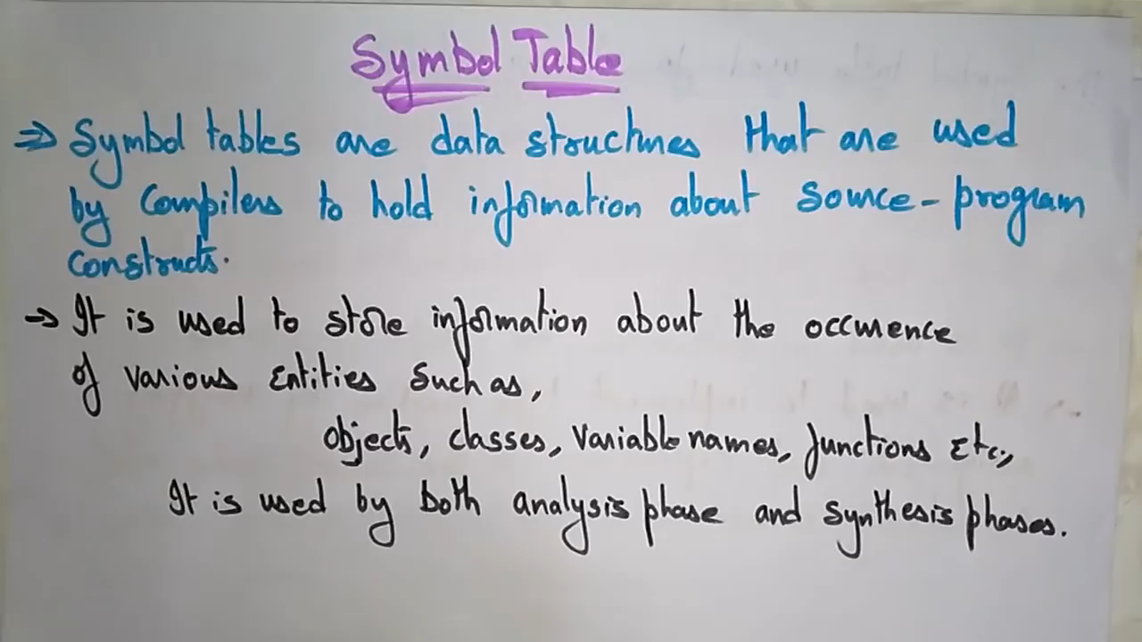
Notes:
https://www.youtube.com/watch?v=QPs6Vkt8C5I

Slide 9


Symbol Table Sample Examination Questions

Slide 10
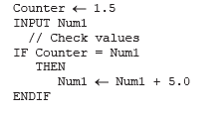
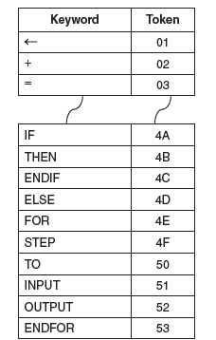
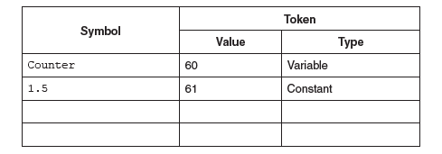
In this question, you are shown pseudocode in place of a real high-level language. A compiler uses a keyword table and a symbol table. Part of the keyword table is shown below. • Tokens for keywords are shown in hexadecimal. • All the keyword tokens are in the range 00 to 5F.
Entries in the symbol table are allocated tokens. These values start from 60 (hexadecimal).
Study the following piece of code:
Complete the symbol table below to show its contents after the lexical analysis stage

Slide 11

Activity
Complete the sample examination questions on the given worksheet Task 2

Slide 12

Reference
https://ecomputernotes.com/compiler-design/phases-of-compiler#Error_Handling

